Slide 1

Working with Chat Completions Part 5

Slide 2
Anne McCaffrey
“I think the Internet, particularly the availability of information, is great. I do a lot of correspondence on-line and have a chat line to talk to my fans as well.”

Slide 3



Notes:
https://www.youtube.com/channel/UC35ZpwldGw7ZJ5R-2sLijzw

Slide 4
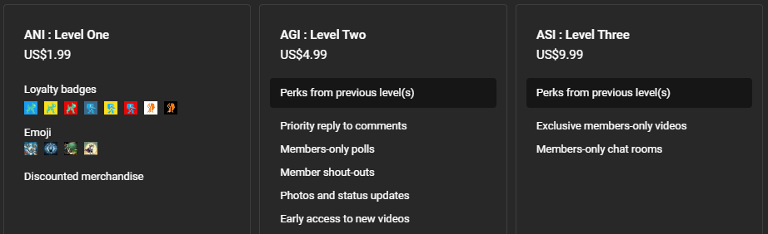
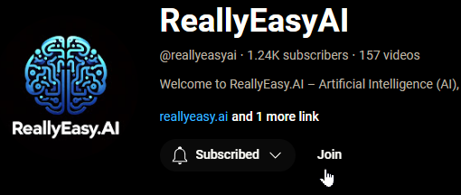
Membership has its privileges
Notes:
https://www.youtube.com/channel/UC35ZpwldGw7ZJ5R-2sLijzw/join

Slide 5
What Are Our Options?
messages
model
frequency_penalty
logit_bias
logprobs
top_logprobs
max_tokens
n
presence_penalty
response_format
seed
stop
stream
temperature
top_p
tools
tool_choice
user
Notes:
https://platform.openai.com/docs/api-reference/chat/create

Slide 6
Using Tools (aka Functions)
The tools argument
Notes:
https://platform.openai.com/docs/api-reference/chat/create#chat-create-tools

Slide 7
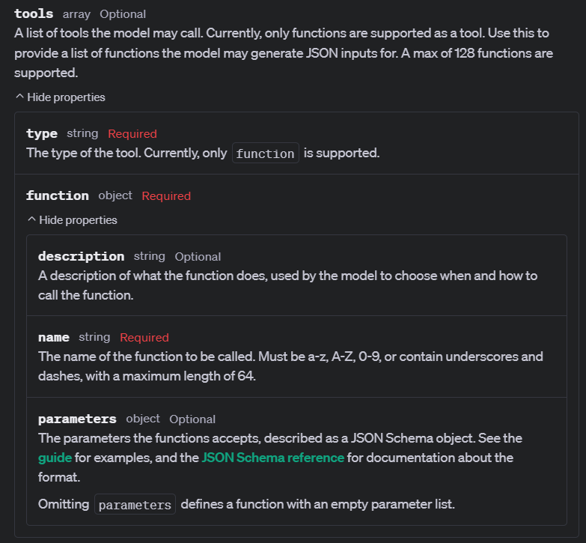
Notes:
https://platform.openai.com/docs/api-reference/chat/create#chat-create-tools

Slide 8
Choosing the Right Tool
The tool_choice argument
Notes:
https://platform.openai.com/docs/api-reference/chat/create#chat-create-tool_choice

Slide 9
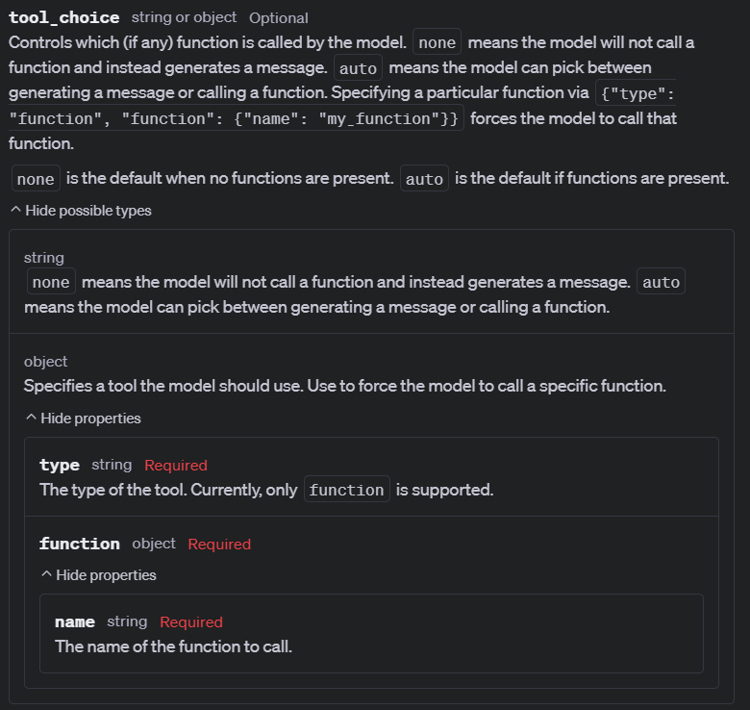
Notes:
https://platform.openai.com/docs/api-reference/chat/create#chat-create-tool_choice

Slide 10


